Slide 1
Linking to a Logged in User

Slide 2
How to Link?
Claims
Session Variables
Foreign Key

Slide 3
Claims
A claim is a piece of information about the logged-in user stored in their identity, e.g.:
  UserId
  Email
  Role
ASP.NET Identity always includes the user’s unique ID in a claim.

Slide 4
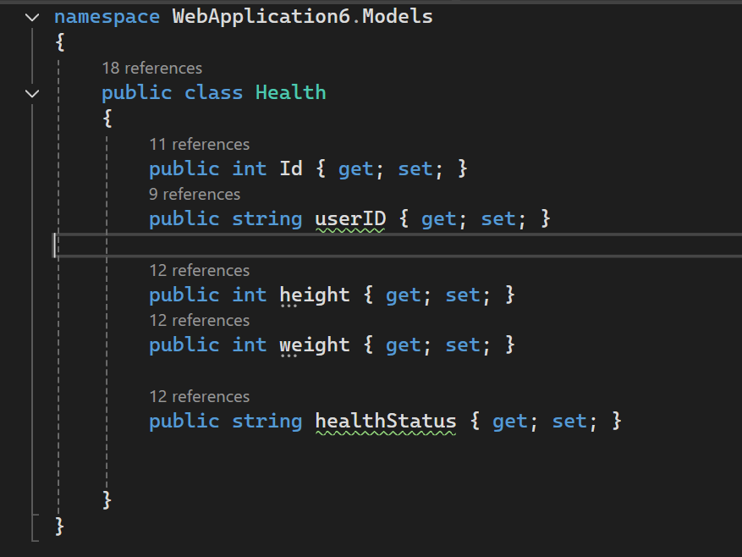
Model Design
Make sure to link the model to the UserId
No Navigation property just a foreign key

Slide 5
Scaffold Controller with views and then add-Migration and Update-Database

Slide 6
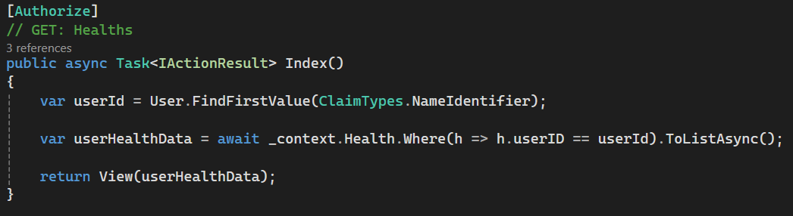
Edit the Index Method – Only current user's details

Slide 7
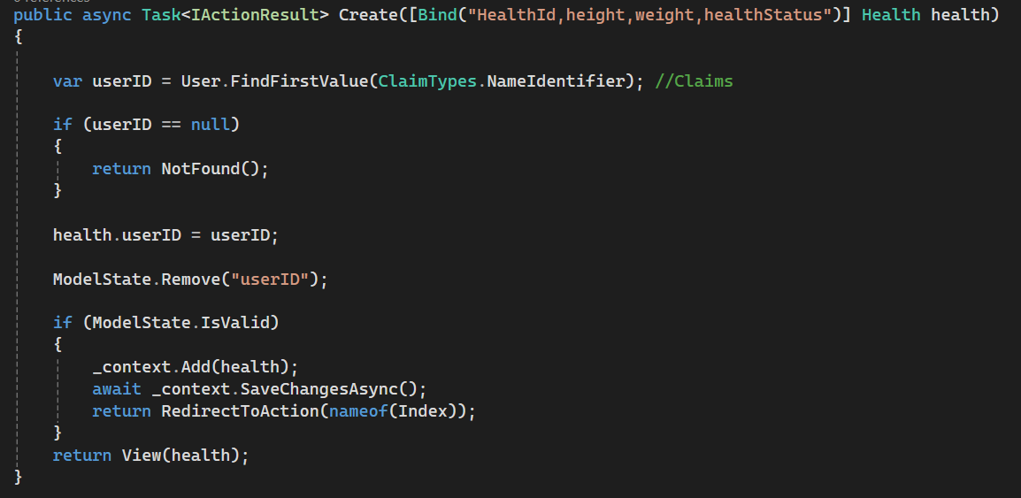
Edit the Create(Post) Method – Only create for the currently logged in user

Slide 8
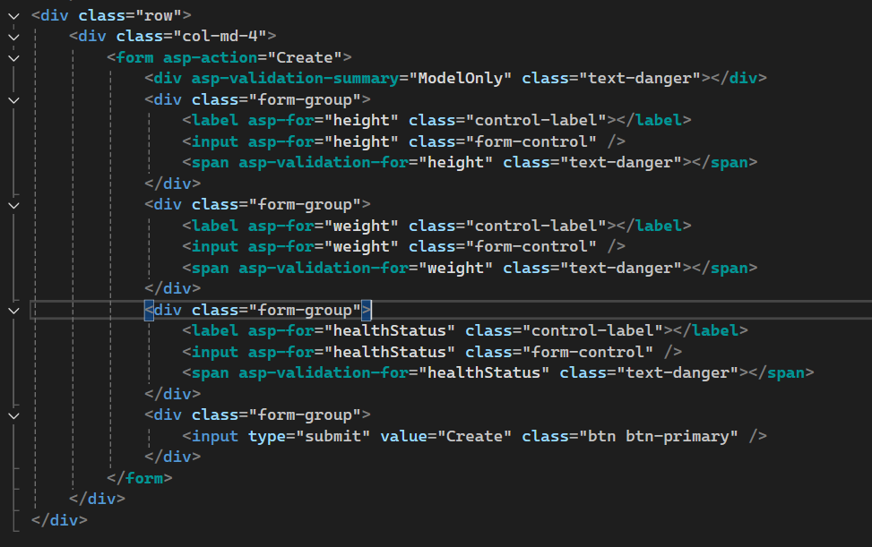
Change the create view so the form does not include the userId

Slide 9
URL HACKING
(IDOR)

Slide 10
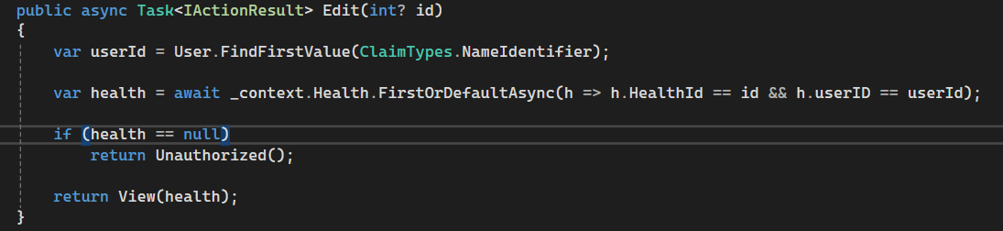
Solution – IMPORTANT FOR SECURITY

Slide 11
Create a book rental system
Should be able to see a list of books
Can select a book to rent
When Renting it will link to the current user
Only able to see my own rentals when logged in

